Slide 1

February 15, 2023

Slide 2
Agenda
Welcome
Board Member and Guest Introductions
Board Members for next election
Approval of January Meeting Minutes
Projects and Procurement Update
Events Update
Fundraising Update
Playground Update
Financials Update

Slide 3
Board Members
Sonia Copeskey, Events Chair
Jason Edelson, Fundraising Chair
Lezlie Mackie, Volunteer Chair
Matt Niemczak, Projects and Procurement Chair
Luann Ray, President
Jennifer Riccolo Debower, Liaison to CPS/LSC
Michelle Sherman, Communications Chair
Jeremy Sutton, Treasurer
Nicole Wood, Secretary

Slide 4
Board Members for Next Election
Confirm by end of the month if continuing on the board
Replacement plan for departing members
Google drive clean up

Slide 5
Projects & Procurement Update
Painting Update
Main floor student bathrooms painted
Cafeteria staff lounge painted
Main building cafeteria painted

Slide 6
Events Update
Saber Soiree February 25, 2023! Committee Update
Bingo/Classroom Art Expo Night 2/21/2023 6-7pm, Free Pizza, Donation for Bingo
Ticket Price Increase Feb 19, 2023!
Family Fundraiser at ClimbZone - March
Next Dine-Out with Le Cafe Station - last week of March TBD
Recommendations for Mom/Dad Saber Socials (locations, connections, etc)

Slide 7
Saber Soiree Update
Tickets to Date
237 tickets sold; 30 Family Sponsorships (had 39 last year)
Ticket prices go up to $150 on 2/19 and $175 day of
Golden Hour
52 tickets sold (8 left)
Separate bar with Palomas & Old Fashions
Eamonn has been asked to do a champagne toast during Golden Hour and small speech rallying people to get the night started in a spirited fashion
Dates to Remember
Auction should go live Monday, February 20th (always iffy on getting it all in. Latest is Feb 21st)
Feb 21, 5:45 pm: Bingo and Art Preview in the Modular Building (bidpal.net/saberbingo2023)
Auction Pick Up 2/28, 3:30 - 5:30 in Main Building Auditorium (pending approval from Mrs. Racasi)
Committee “End of Year” dinner is Thursday, March 16th
Final Details
Menu has been chosen, Headcounts due, working on Run of Show, creating Signage, powerpoint, etc, etc
Sponsorship total: $20,200 ($14,600 in 2022)
Auction Items: currently ~218 confirmed items valued at ~$40,000…constantly growing this week (2022: 295 valued at $43,200)
25 art projects, 24 Teacher Experiences (some individual, some grade level)
Lots missing from this update simply due to the overwhelming amount of work we’re doing these last 10 days; please ask any specifics

Slide 8
Fundraising Update
Launch after Saber Soiree
Looking for volunteers
Negotiated free training with Neon
Stickers being printed shortly

Slide 9
Playground Update
We are working with the landscape architect on short term and long term options to upgrade the middle playground.
Planning a poster for the Saber Soiree that highlights:
Why we are pursuing a phased approach (budget)
What we plan to present to the community
Importance of feedback
Next steps:
Develop display board for the Soiree.
Continue refining design options to present to the community.
Help needed: The phased approach is contingent upon using the Job Order Contract (JOC) process through facilities management vs. the capital group at CPS. We have not been able to discuss this option with the facilities manager (Tikeila McKenzie) to determine feasibility (not responsive). Do we have any options to escalate this so we can determine the steps / timeline to move forward?

Slide 10
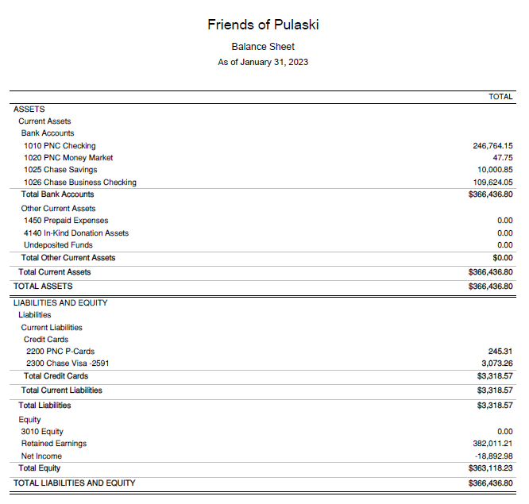
Financial Update
$366k in cash vs. $279k prior to 2022 Saber Soiree
New bookkeeper is live and revising old financials and transactions
In process on 2022 tax return
Majority of changeover to Chase banking is complete, finishing after Saber Soiree
Likely we will need to collect W9s and send out 1099s for 2022 services and all non-goods payments over $600 going forward

